Slide 1
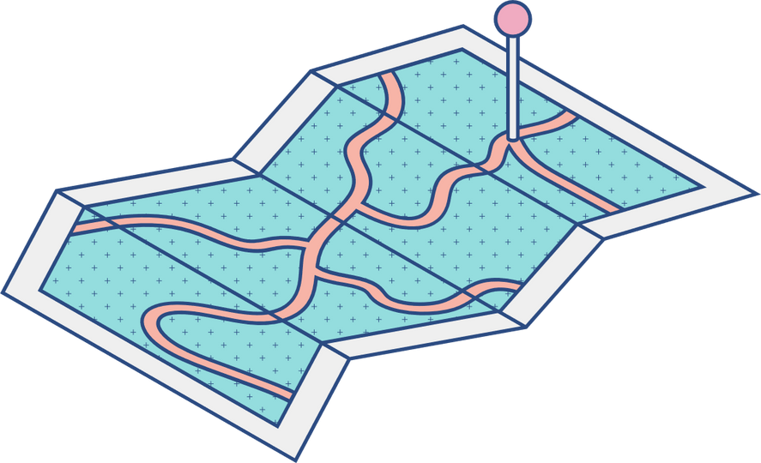





Project:
Internship IU
Present by: Trần Hải Nam-ITITIU19161
Advisor: Huynh Kha Tu, Ph.D
Reviewer: Assoc. Prof. NGUYEN Van Sinh, Ph.D

Slide 2

1
Problem Statement
Table of content
2
Analysis
3
Implement and demo

Slide 3
Problem Statement

Slide 4
Problem of Student
Difficulty in obtaining information about the internship process
Difficulty in finding work with reputable companies
Difficulty finding report templates and submitting reports to teachers
It's hard not knowing how to write a cv and how to submit it

Slide 5
Problem of Teacher
Takes time in compiling student information for grading and reporting
Difficulty in student management and student support

Slide 6
Analysis

Slide 7
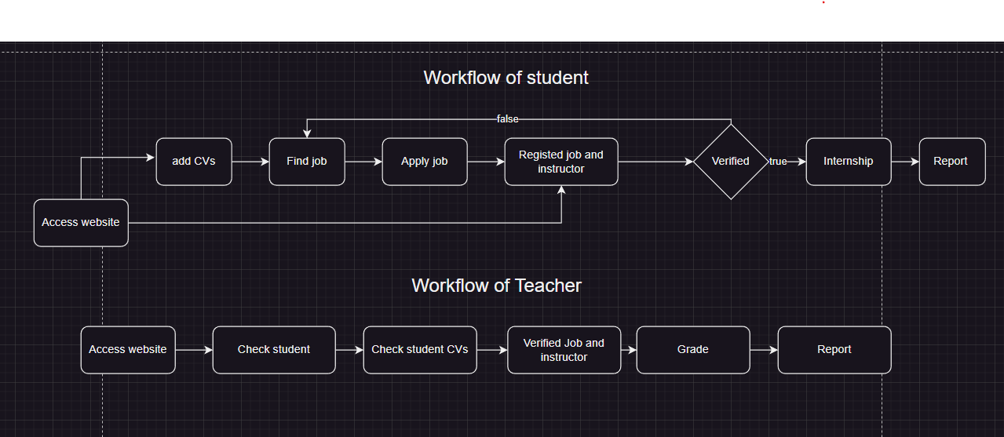
Workflow

Slide 8
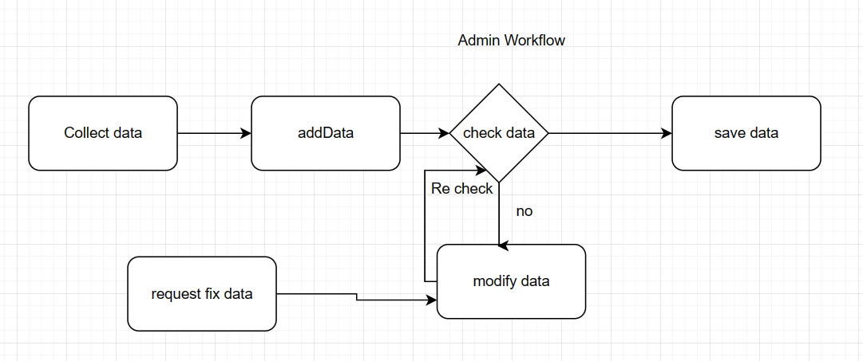
Workflow

Slide 9
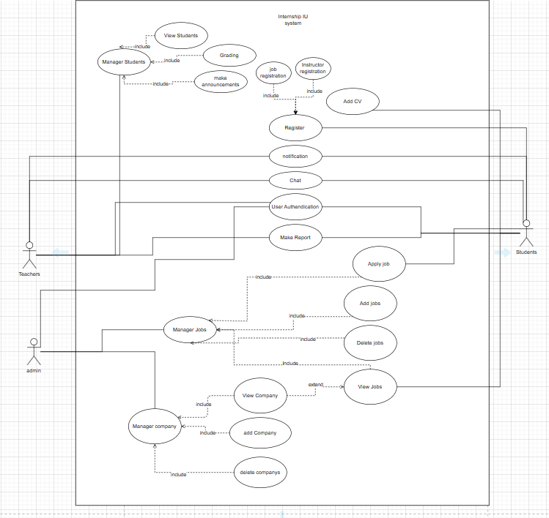
Usecase diagram

Slide 10
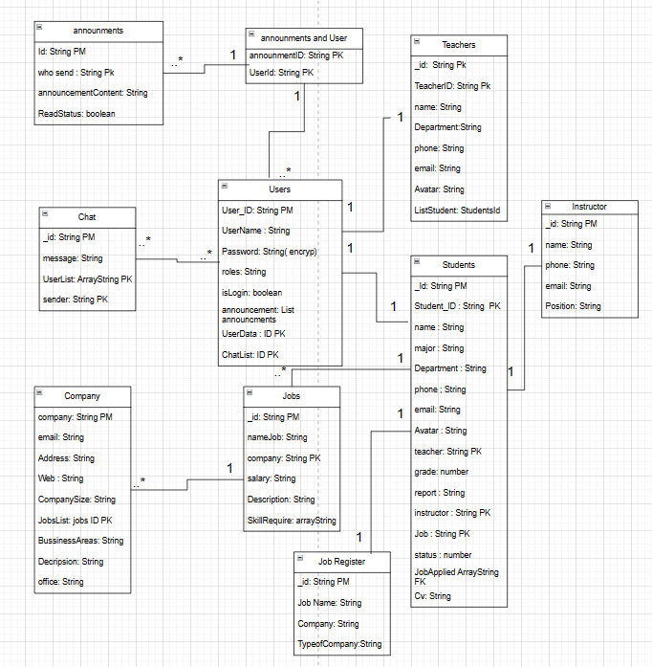
Database diagram

Slide 11
Implement and Demo

Slide 12
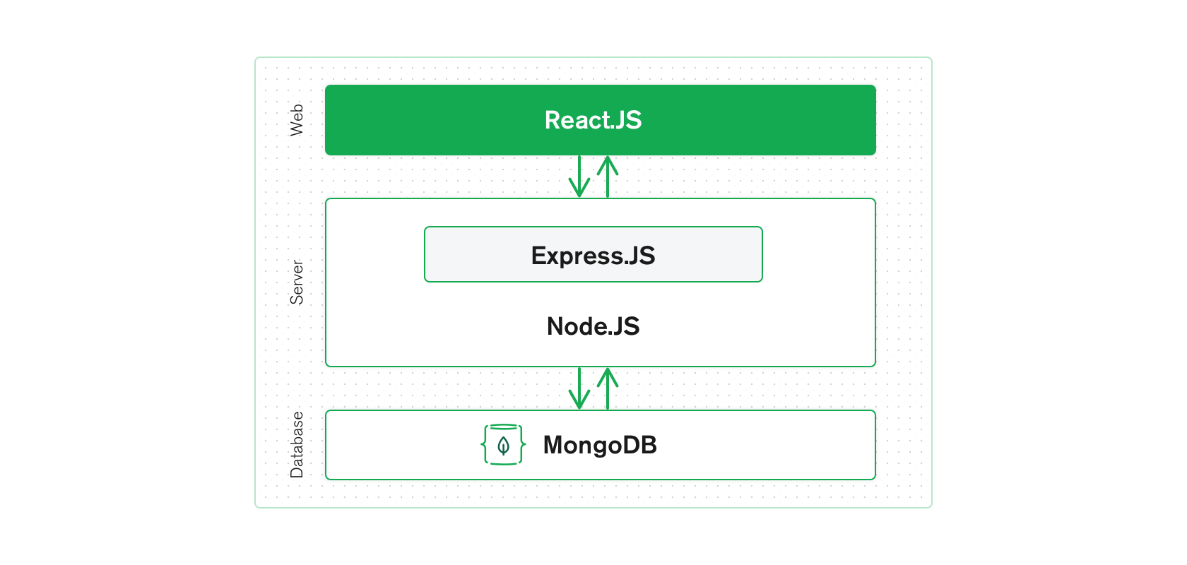
Technical
What is MERN Stack?
- MERN stands for MongoDB, Express, React, Node, after the four key technologies that make up the stack.
Why choose the MERN stack?
- Easily construct a three-tier architecture.
- There is a large community support and many sample projects.
- Both the front end and backend share the same JSON Data Stream, making future maintenance and upgrades easier.

Slide 13








Vite
Node.js
Reactjs
Express.js
Mui Material UI
Socket.IO
Front End side
Server side
MongoDB
Docker
DataBase
Deployment

Slide 14
UI Design
Pages for Student
Pages related to jobs and companies
Page to view personal information
Pages to post CVs as well as Reports
Page to register instructors and Jobs.
Users
Authentication &&
Authorization
Pages for Teacher
Pages to manage students
Login request
Pages for grading students
Page to post Report for school
Pages for administrator
User management pages
Company management pages
Job management pages

Slide 15
Server design
Server-side Systems
APIs Server:
- Handle user in website
- Handle data information in website
Client
(Browser)
Http request
Database
Chat Server:
- Run Socket.io
- Handle Chat service in website
Http response
Files Server:
- Handle file storage work.
- Steam files for Browser can be used.

Slide 16
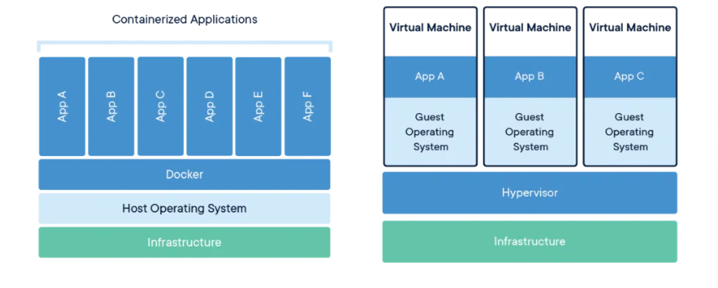
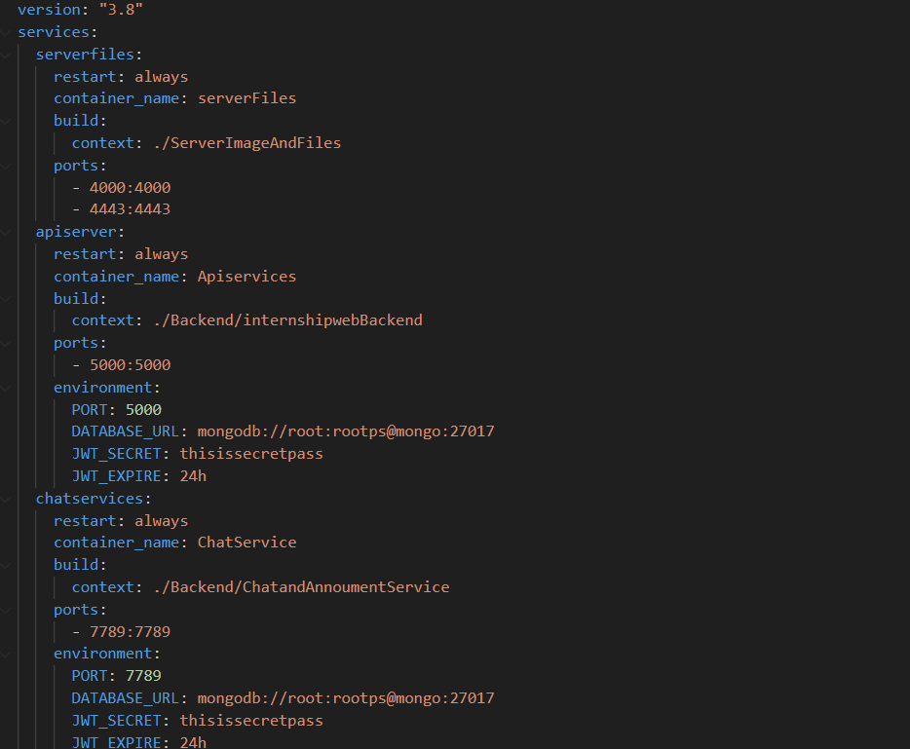
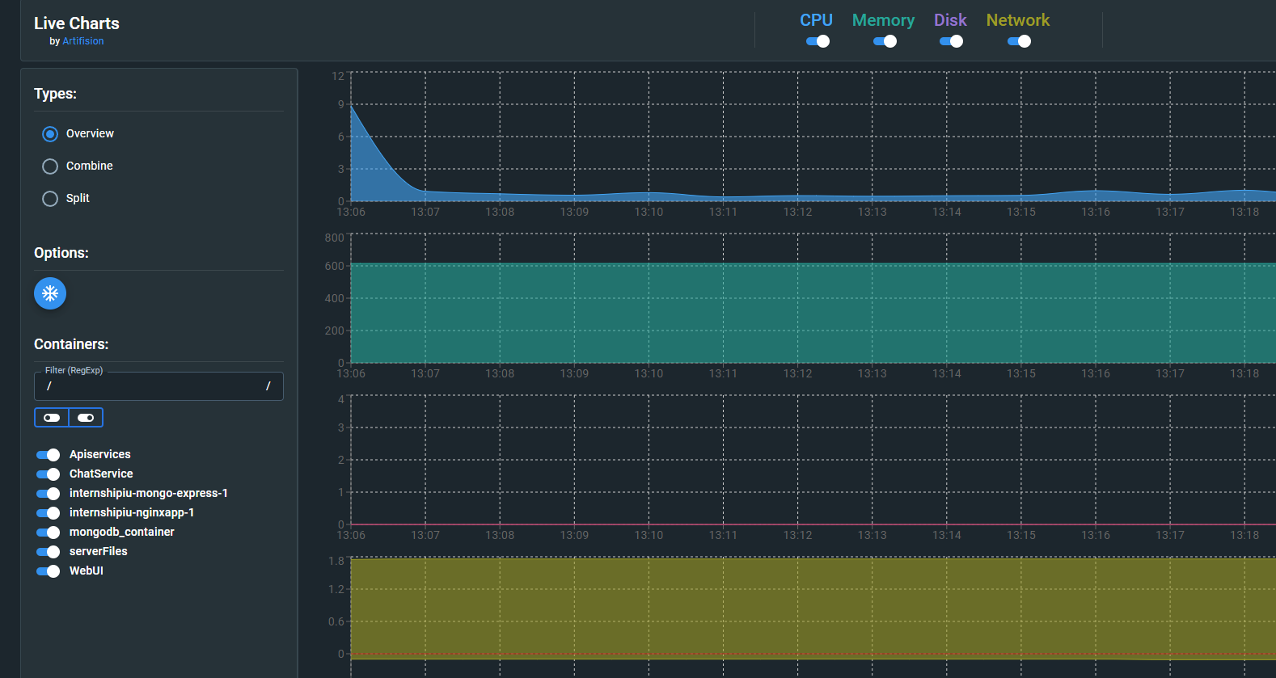
Deploy on docker

Slide 17
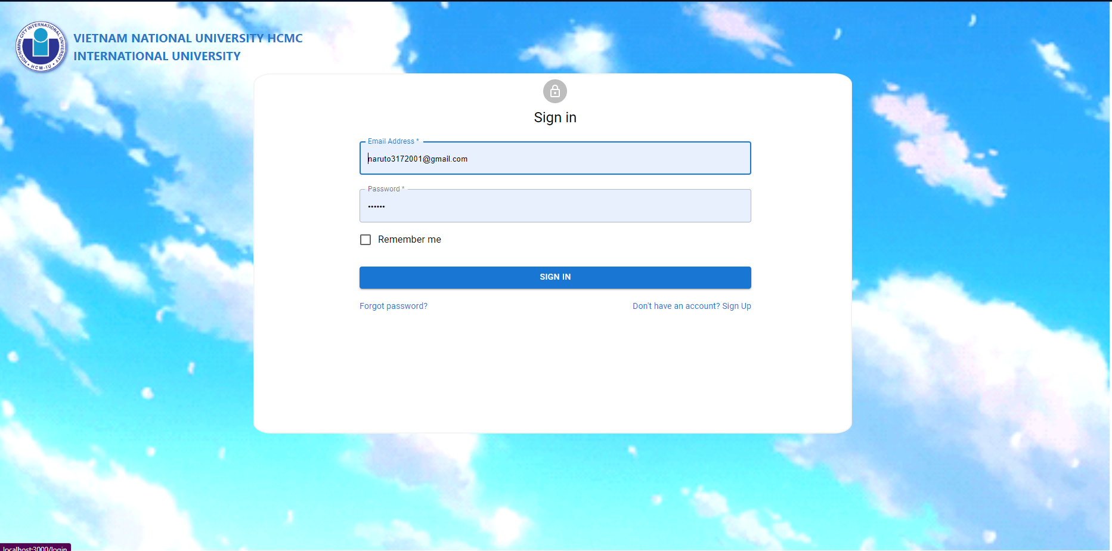
Demo

